Slide 1
Personality Traits of Leaders
What type of personality traits does it take to lead?

Slide 2
Objectives
Define personality traits
Describe and understand the “Big Five Model of Personality”
Personality Styles of leaders

Slide 3
Definitions
Trait – Distinguishing personal characteristics
Personality – a combination of traits that classifies as individual’s behavior

Slide 4
The Big Model of Personality
Surgency
Agreeableness
Adjustment
Conscientiousness
Openness to Experience
Lussier, R. N. and Achua, C. F. (2001).

Slide 5
Surgency
Leadership and extraversion traits.
  Interesting in getting ahead
  Leading through influencing
  Individuals are outgoing
  Likes to meet new people
  Willing to confront others

Slide 6
Agreeableness
Traits related to getting along with others.
  Characteristics include warm, easygoing, compassionate, friendly, and sociable.
  Individuals typically are sociable and have lots of friends.

Slide 7
Adjustable
Traits related to emotional stability.
  Stable is being calm, good under pressure, relaxed, and secure
  Unstable is nervous, poor under pressure, insecure

Slide 8
Conscientiousness
Includes traits related to achievement.
  Traits include high credibility, consistency, and association.
  Individuals typically work hard and put in extra time and effort to meet goals.

Slide 9
Openness to Experience
Trait related to being willing to change and try new things.
  Individuals typically are willing to take calculated risks.

Slide 10
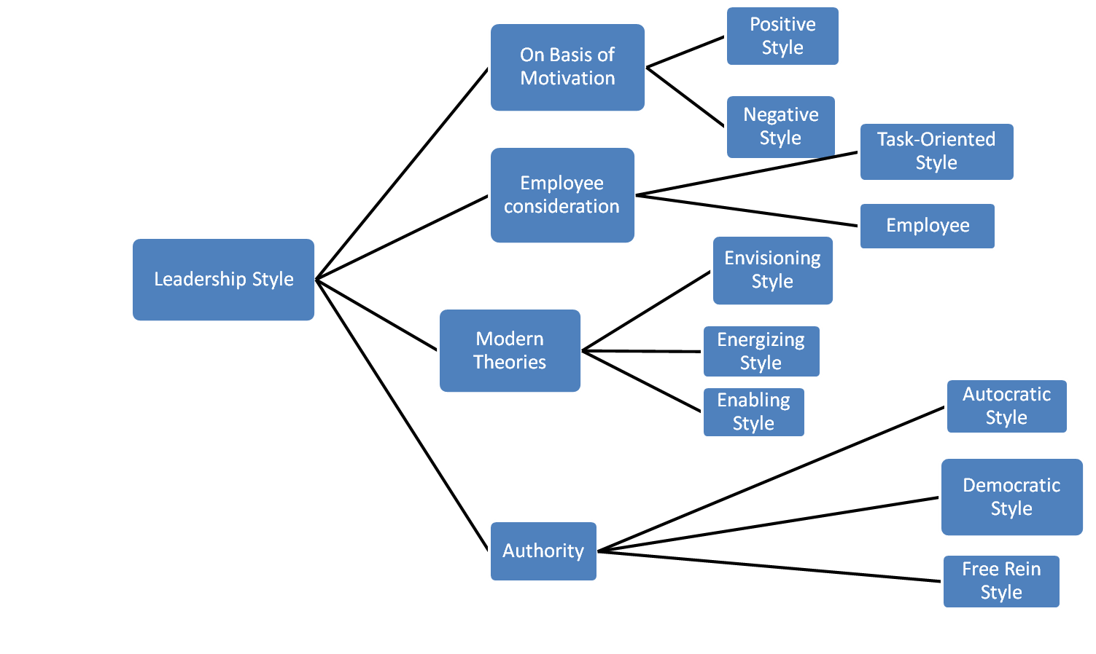
Leadership Styles
Notes:
The trait theory of leadership looks at personality, social, physical, or intellectual traits that differentiate leaders from nonleaders. Initially this theory was based on studies that looked at over 80 different traits, which allowed almost anything to be defined as leadership. A breakthrough occurred when researchers began to organize the traits into categories and this became known as the Big Five Personality Framework where five groups of traits were found to be consistently present among leaders.
Some essential leadership traits include extroversion, conscientiousness, openness, and emotional intelligence (EI), although the link between EI and leadership has not been fully explored.
With the many years of research dedicated to the trait theory of leadership, it is widely accepted that traits do predict leadership. However, it is more likely that they predict the emergence of a leader than the effectiveness of a leader.
(c) 2008 Prentice-Hall, All rights reserved.

Slide 11
Leadership Styles
Positive Style
  Leader uses positive means like appreciation, praise, rewards, etc to lead followers
Negative Style
  Leader uses negative means like criticism, punishment, penalty, etc to influence followers
Employee-Oriented Style
  Interest/welfare of employees is given priority
  Employees are centre of every decision
Task-Oriented Style
  Tasks are given priority over employees
Notes:
The trait theory of leadership looks at personality, social, physical, or intellectual traits that differentiate leaders from nonleaders. Initially this theory was based on studies that looked at over 80 different traits, which allowed almost anything to be defined as leadership. A breakthrough occurred when researchers began to organize the traits into categories and this became known as the Big Five Personality Framework where five groups of traits were found to be consistently present among leaders.
Some essential leadership traits include extroversion, conscientiousness, openness, and emotional intelligence (EI), although the link between EI and leadership has not been fully explored.
With the many years of research dedicated to the trait theory of leadership, it is widely accepted that traits do predict leadership. However, it is more likely that they predict the emergence of a leader than the effectiveness of a leader.
(c) 2008 Prentice-Hall, All rights reserved.

Slide 12
Leadership Styles
Envisioning Style
  Leader creates a picture of desired future state/result
  Leaders clarifies vision and set high goals and expectations
Energizing Style
  Way of motivating employees to put maximum efforts
Enabling Style
  Leader tries to empower followers and offers personal support to do the difficult job effectively
Notes:
The trait theory of leadership looks at personality, social, physical, or intellectual traits that differentiate leaders from nonleaders. Initially this theory was based on studies that looked at over 80 different traits, which allowed almost anything to be defined as leadership. A breakthrough occurred when researchers began to organize the traits into categories and this became known as the Big Five Personality Framework where five groups of traits were found to be consistently present among leaders.
Some essential leadership traits include extroversion, conscientiousness, openness, and emotional intelligence (EI), although the link between EI and leadership has not been fully explored.
With the many years of research dedicated to the trait theory of leadership, it is widely accepted that traits do predict leadership. However, it is more likely that they predict the emergence of a leader than the effectiveness of a leader.
(c) 2008 Prentice-Hall, All rights reserved.

Slide 13
Leadership Styles
Autocratic Style
  Leader is whole and sole
  Decision making is fully centralized
  Leader limits communication with followers
Democratic Style
  Involvement of followers in decision making
  Two-way communication
Free Rein Style
  Leader plays minimum role
  Employees are given freedom to decide and work
Notes:
The trait theory of leadership looks at personality, social, physical, or intellectual traits that differentiate leaders from nonleaders. Initially this theory was based on studies that looked at over 80 different traits, which allowed almost anything to be defined as leadership. A breakthrough occurred when researchers began to organize the traits into categories and this became known as the Big Five Personality Framework where five groups of traits were found to be consistently present among leaders.
Some essential leadership traits include extroversion, conscientiousness, openness, and emotional intelligence (EI), although the link between EI and leadership has not been fully explored.
With the many years of research dedicated to the trait theory of leadership, it is widely accepted that traits do predict leadership. However, it is more likely that they predict the emergence of a leader than the effectiveness of a leader.
(c) 2008 Prentice-Hall, All rights reserved.

Slide 14
Effective Leader Traits
Dominance
Flexibility
Stability
Self Confidence
Sensitivity to Others
Intelligence
High Energy
Locus of Control
Integrity

Slide 15
Derailed Leadership Traits
Bullying Style
Viewed as being cold / arrogant
Betrayed personal trust
Self centered
Unable to delegate
Low performing organization

Slide 16
Conclusions
You don’t have to have all these traits
You need to know your own self
Know your strengths / weaknesses
Work on the weak points to get better

